Slide 1
Africa's Fuel Markets & the Future of Refining
OTL Africa Downstream Week 2022
25th October 2022
Isiyaku Abdullahi
MD PPMC, NNPC Limited

Slide 2
Content Outline
01
Introduction
The Market Size And The Major Players
The Key Market Drivers
Product Sourcing And Refining
Product Portfolio
Africa’s Energy Mix
Product Pricing And Subsidy Regimes
The Impact Of Net Zero Emission On The Market
Conclusion
02
03
04
05
06
07
08
09

Slide 3
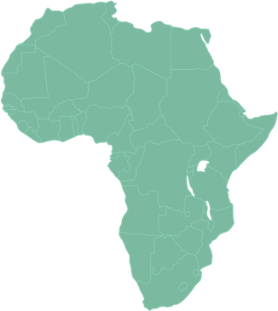
Introduction
Africa’s population is 1.37 billion, with an increasing energy demand at an annual rate of around 3%, the highest among all continents but the supply continues to lag significantly
Crude oil exports
~5.6 million bbl/day
(2021)
Proven crude oil reserves 125.3 billion barrels
Potential of over
630TCF natural gas
Sources: Statista

Slide 4
THE MARKET SIZE AND THE MAJOR PLAYERS
OIL
GAS
COAL
Oil demand in Africa stood at an average of 4.36 million barrels per day in 2022. Even though Africa has the world’s lowest levels of per capita use of modern Energy, its demand is set to increase with growth in population and incomes. As its population and incomes grow, demand for modern energy expands by a third between 2020 and 2030 in the SAS.
Today, 970 million Africans lack access to clean cooking gas.
Reserve
125.1 Bbo
455 tcf
14.8 bt
Production
6.8 mmbbl/d
231 bcm
6.47 EJ
Consumption
3.5 mmbbl/d
153 bcm
4.1 EJ
Export
5.7 mmbbl/d
26.1 bcm
NA
Discoveries
551 mmbbl
343 mmbbl
NA
Sources: PwC, Statista

Slide 5
The Key Market Drivers
Population growth rate has been consistently over 2.45 percent
Population growth, an expanding middle class, industrialization, trade, urbanization, and climate change are the major drivers of energy demand
Rapid demographic change will continue to drive up demand for energy services across Africa in the coming decades
Real GDP is projected to keep a stable and constant growth trend of around 4%
“Africa shows a growth rate of 3.3 per cent. This is attributable to stable growth rates in Nigeria and Egypt, together with solid production increases in Angola, Mauritania and other economies of this region.” - World Manufacturing Production Quarter II 2022 Report
“One‑third of Africa’s per capita GDP growth is due to urbanization.”
- Africa’s Urbanisation Dynamics 2022 © Oecd/United Nations 2022
Sources: PwC, Statista, UNIDO, OECD

Slide 6
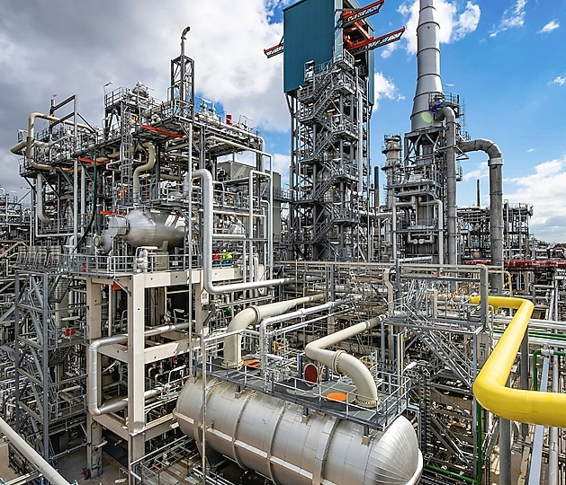
Product Sourcing & Refining
Despite huge reserves, the bulk of Africa’s resources is still being exported
Majority of African countries primarily relies on the import of refined product to sustain domestic economies
Refinery performance is generally limited by refining capacity and inadequate maintenance
In total, refining capacity across the continent amounts to 3.5 million barrels per day (mb/d), 60% of which is in North Africa
The average utilization rate in 2020 was below 60% across the continent and under 40% in sub‐Saharan Africa (and lower still in some countries such as Nigeria)
“When completed, the Dangote Refinery in Nigeria will reduce import exposure. But it will not cover the full fuel import requirements for the continent, especially with rising liquefied petroleum gases (LPG) demand, which grows by 40% between 2021 and 2030.”
Sources: IEA

Slide 7
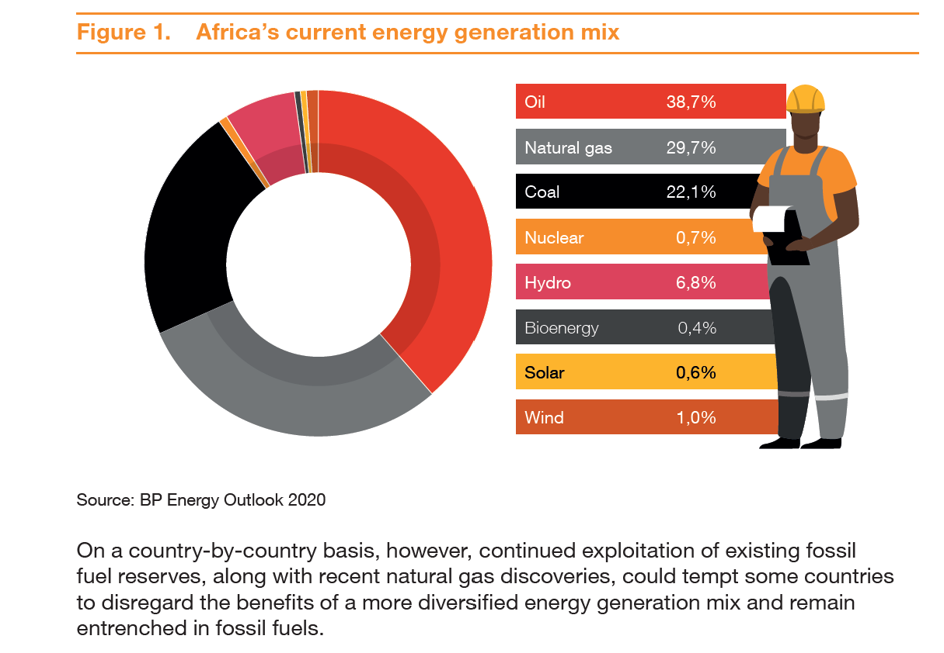
Africa’s Energy Mix
With heightened campaigns on the use of sustainable energy sources and a match into a net-zero world, the energy mix becomes more diverse, but Africa’s current energy mix is still dominated by fossil fuel with hydropower making the only meaningful renewable energy contribution
Fossil fuel continues to contribute more than 50% to the Energy Mix in Africa
Sources: PwC

Slide 8
THE PRODUCT PRICING AND SUBSIDY REGIMES
The world spends an astounding US$423 billion annually to subsidize fossil fuels for consumers. - UN
The average price of gasoline in the world for this period is 1.27 U.S. Dollar.
Over half the countries in Sub-Saharan Africa subsidize fuel to protect consumers from high and volatile prices.
Consumers living in oil producing countries in Africa spent less money on gasoline. For instance, one liter cost 0.03 U.S. dollar in Lybia and 0.40 U.S. dollar in Nigeria that is the biggest fuel exporter in Africa.
World Average Price $1.27
Sources:

Slide 9
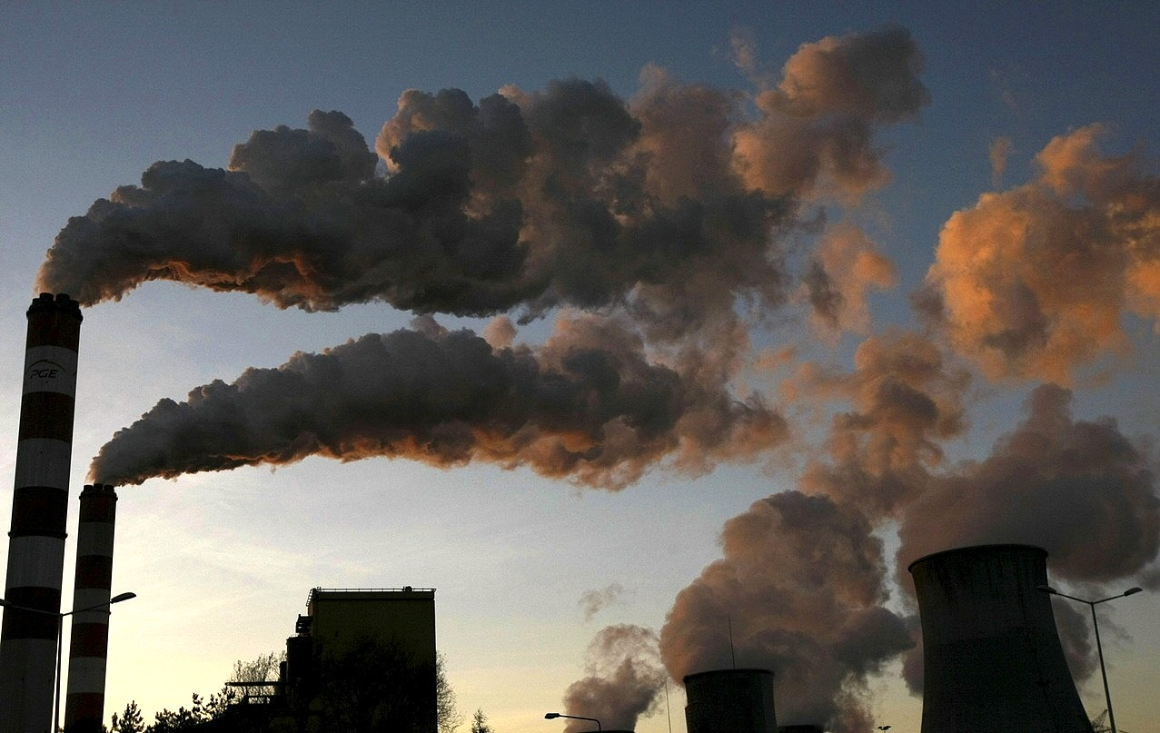
THE IMPACT OF NET ZERO EMISSION ON THE MARKET
With 17% of the world’s population,
Africa currently produces less than 5% of global emissions
According to PwC estimates, it would cost Africa around $2.8tn to reach a net-zero energy mix by 2050.
This would include annual costs of circa $33bn between 2020 and 2030; $111bn between 2030 and 2040; and $142bn between 2040 and 2050.
Despite increasing pressure to exit fossil fuels, investors still see the potential of natural gas in the transition to cleaner energy sources, as it has scale to satisfy growing global demand and fuel switching from coal.
Sources: PwC

